Slide 1

JOSH O'BRIEN
STARTUP VEGAS 2026
YOUR DIGITAL WORKFORCE
Intro to Business Automation
Building a business that helps you run it — capture, qualify, onboard, offboard — with Notion, n8n, and Claude.
Notes:
Opener. 'By the end of this, you'll have seen a business run itself — leads qualifying themselves, clients onboarding in one click, and automations we build live on stage.'

Slide 2
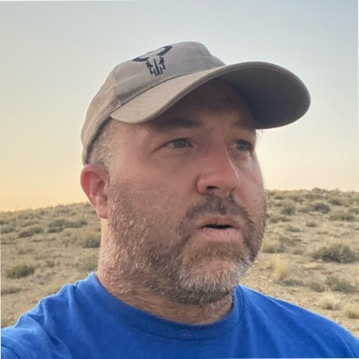
YOUR SPEAKER
Josh O'Brien
Manager of DevOps and Infrastructure @ Tensorwave
With over 30 years of experience in engineering and IT leadership, Josh O'Brien is recognized for scaling complex infrastructure, building high-performing teams, and delivering operationally resilient platforms.
Notes:
Quick intro — ~20 seconds. The demos are the star.

Slide 3

THE FOUNDATION
Your Business Operating System
You've run an operating system since day one — a paper ledger, a whiteboard schedule, an inbox, sticky notes, phone reminders. The processes never change; only the tooling matures, left to right, from Crawl to Fly and beyond.
PROCESS | CRAWL | WALK | RUN | FLY & BEYOND
Money & Books | Paper ledger | Spreadsheet | Accounting app | Auto bookkeeping
Schedule & Work | Whiteboard | Shared calendar | Project system | Auto scheduling
Contacts & Comms | Rolodex / inbox | Contact list | CRM | AI-scored CRM
Knowledge & How-To | Notebook & notes | Computer notes | SOP library | AI knowledge bot
Tasks & Follow-ups | To-do pad | Phone reminders | Task database | AI that acts
Same processes, better tooling. The “Run” column is your foundation — today we automate the bridge from Run toward Fly.
Notes:
Reframe the idea: you didn't lack a system before — it lived on paper, whiteboards, and your phone. Automation isn't a brand-new system; it's the same processes with better tooling, maturing from Crawl to Fly. Point at the columns: paper/manual, to basic digital, to connected systems (the Notion build we demo today), to AI/autonomous — and beyond.

Slide 4

THE AUTOMATION CONTINUUM
CRAWL
WALK
JOG
RUN
FLY
Crawl
No automation — and that's fine at first. You run the entire business on email and a spreadsheet.
Everything is manual — it lives in your head, your inbox, and one spreadsheet.
NEXT — WALK →
No real tools yet; email and a spreadsheet hold it all together.
You outgrow what email and a spreadsheet can handle.
Zero automation.
Notes:
Crawl = no automation at all. Just email and a spreadsheet, and for a while that's genuinely enough. The catalyst to move on: you simply outgrow what those two tools can hold.

Slide 5

THE AUTOMATION CONTINUUM
CRAWL
WALK
JOG
RUN
FLY
Walk
You start adopting tools to define your processes — but the work between them is still done by hand.
Tools begin to shape how you work — a CRM, invoicing, documents.
NEXT — JOG →
You manually import or copy-paste data between systems.
You miss something important — a dropped ball you can't afford.
Templates exist for onboarding and invoices, but most of it is still manual.
Notes:
Walk = tools start defining your process, but you're still manually moving data between systems. You've got templates for onboarding and invoices, yet most of it is hand-done. The catalyst: you drop an important ball.

Slide 6
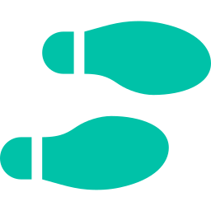
THE AUTOMATION CONTINUUM
CRAWL
WALK
JOG
RUN
FLY
Jog
You grab the low-hanging fruit — the obvious tooling wins that plug the gaps and save you.
Scheduling links (Calendly) embedded right into your onboarding emails.
NEXT — RUN →
Your CRM and more mature tools start carrying real weight.
Something in the loose, stitched-together system fails — now you have to harden it with real tooling.
It works — but it's a loose system, stitched together.
Notes:
Jog = reaching for low-hanging fruit: Calendly embedded in onboarding emails, leaning on the CRM and more mature tools. It works, but it's loose and stitched together. The catalyst: a failure in that loose system forces you to harden it.

Slide 7

THE AUTOMATION CONTINUUM
CRAWL
WALK
JOG
RUN
FLY
Run
Real tooling supports the whole business OS — and now automation does the routine work for you. This is what today's talk is all about.
An actively-used CRM, document repos, and well-documented processes.
NEXT — FLY →
Automation handles the routine — lead capture, onboarding, follow-ups.
Tightly couple every automation, then add reporting and guardrails — so nothing fails silently.
Reliable systems, each doing its job for you.
Notes:
Run = real tooling supporting the whole Biz OS, plus automation now doing the routine work — lead capture, onboarding, follow-ups. This is exactly what today's talk teaches you to build. The catalyst to Fly: tightly couple it all and add reporting and guardrails.

Slide 8

THE AUTOMATION CONTINUUM
CRAWL
WALK
JOG
RUN
FLY
Fly
Every automation is tightly coupled into one system — with reporting and guardrails that stop silent failures before they happen.
Automations and tools are tightly integrated, end to end.
THE PAYOFF
Reporting gives you live visibility into everything running.
One tightly-coupled system that runs itself — and tells you the moment something needs you.
Guardrails catch and surface problems — no silent failures.
Notes:
Fly = the automations from Run, now tightly coupled into one system, with reporting for visibility and guardrails that prevent silent failures. The business runs as one — and surfaces problems instead of hiding them.

Slide 9

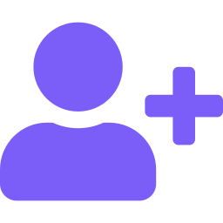
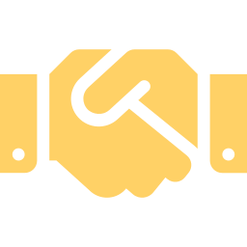
WHAT WE'LL BUILD
Three automations, one connected system
The whole client lifecycle — captured, qualified, onboarded, and offboarded — running on autopilot.
01
02
03
Qualify
Onboard
Offboard
AI scores and enriches every inbound lead the instant it arrives.
One button turns a signed prospect into a fully set-up client.
Close the loop — retire the client, capture the testimonial.
Notes:
Roadmap. We go in lifecycle order: a lead qualifies itself, a client onboards in one click, then offboards in one click.

Slide 10

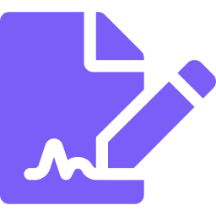
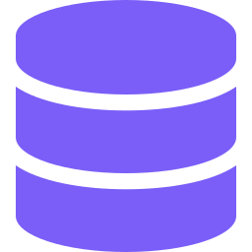
AUTOMATION 01
AI Lead Qualification
Every inbound lead, read and ranked by AI the instant it arrives.
Instant scoring
Auto-enrichment
Claude rates each lead 1–10 and sets priority — no manual triage.
Industry, buying intent, company size and deal range, from one form.
Sales-ready summary
Lands in your CRM
An executive summary and recommended next action for your follow-up.
The scored record appears in Notion in seconds, ready to action.
No lead goes cold. No hour of research. The qualifying happens before you ever read it.

Slide 11

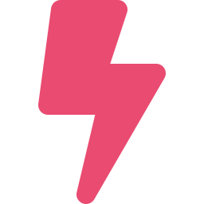

LIVE DEMO 01
Watch a lead score itself
A form submission becomes a fully-scored CRM record in seconds.
STEP 1
STEP 2
STEP 3
Landing Page
n8n Execution
Notion CRM
Fill out the contact form
Claude scores it live
Scored lead appears
↳ Open the linked screens in the speaker notes, in order, as you go.
Notes:
LIVE DEMO 1 — AI LEAD QUALIFICATION ON-SCREEN ORDER (switch in this sequence): 1) Landing page — fill out the contact form: https://joshobrien77.github.io/AutomationKIT/ 2) n8n execution — watch Claude score it: https://obrienretailservices.app.n8n.cloud/home/executions 3) Notion CRM, New Leads view — show the scored lead: https://app.notion.com/p/da223aa958fd45a8b76f9aae18c36de3 SAY: 'When someone fills out my site, normally I'd read it, research the company, and score it by hand. Watch AI do it live.' DO: Fill the form — make the Bottleneck specific. Submit (instant success). Flip to n8n, narrate the run. Flip to CRM, open the new lead, read Claude's summary + score out loud. PAYOFF: 'I never typed any of that — Claude scored them, estimated the deal, and wrote the summary before I finished talking.'

Slide 12


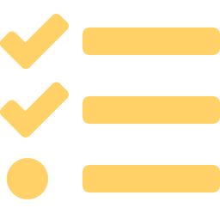
AUTOMATION 02
Client Onboarding
One button turns a signed prospect into a fully set-up client.
Activate the client
Spin up the project
Status flips to Client and the start date is stamped automatically.
A linked project workspace is created and tied back to the client.
Welcome them
Queue the work
A warm, personalized welcome email goes out from your own mailbox.
Kickoff and requirements tasks are created with due dates.
An hour of copy-paste setup, collapsed into one click and three seconds.

Slide 13
LIVE DEMO 02
One click, a whole client set up
Add a client, press a button, and the onboarding cascade fires.
STEP 1
STEP 2
STEP 3
Notion CRM
n8n Execution
Notion + Inbox
Add client → Onboard
The cascade fires
Project, tasks, email
↳ Open the linked screens in the speaker notes, in order, as you go.
Notes:
LIVE DEMO 2 — CLIENT ONBOARDING ON-SCREEN ORDER: 1) Notion CRM — add a client row (Name, Company, Email = your demo inbox), click the Onboard Client button: https://app.notion.com/p/da223aa958fd45a8b76f9aae18c36de3 2) n8n execution — watch the cascade: https://obrienretailservices.app.n8n.cloud/home/executions 3) Notion (Projects + Tasks) and your email inbox — show the results: https://app.notion.com/p/388c6115f2e08164bf62f9cd8b3cb4f9 SAY: 'Signing a client normally means an hour of setup. Watch one button do it.' DO: Click Onboard Client. Flip to n8n (green cascade). Flip to Notion: status → Client, a new linked project, two tasks; then show the welcome email in your inbox. PAYOFF: 'Three seconds: CRM updated, project live, client emailed, tasks queued — nothing manual.' SETUP: set the new row's Email to an inbox you can show on screen.

Slide 14


AUTOMATION 03
Client Offboarding
Close every engagement cleanly — and never forget the testimonial.
Retire the client
Close the project
Status moves to Alumni so your pipeline stays accurate.
The project is marked Complete and flagged Offboarded.
Say thank you
Capture value
A wrap-up email thanks the client and invites a referral.
Testimonial-request and asset-archival tasks are auto-created.
The loop closes itself — relationships end warm, and nothing slips through the cracks.

Slide 15
LIVE DEMO 03
Close the loop in one click
Wrapping up a client retires them, closes the project, and queues the testimonial.
STEP 1
STEP 2
STEP 3
Notion CRM
n8n Execution
Notion
Click Offboard Client
The wrap-up runs
Alumni + complete
↳ Open the linked screens in the speaker notes, in order, as you go.
Notes:
LIVE DEMO 3 — CLIENT OFFBOARDING ON-SCREEN ORDER: 1) Notion CRM — on a current client (e.g. Diana Rosales / Summit), click the Offboard Client button: https://app.notion.com/p/da223aa958fd45a8b76f9aae18c36de3 2) n8n execution — watch it run: https://obrienretailservices.app.n8n.cloud/home/executions 3) Notion — show Alumni status, project Complete + Offboarded, and the closeout tasks: https://app.notion.com/p/388c6115f2e08164bf62f9cd8b3cb4f9 SAY: 'And when an engagement wraps, one button closes the loop.' DO: Click Offboard Client. Flip to n8n. Flip to Notion: client → Alumni, project → Complete (Offboarded checked), testimonial + archive tasks created, wrap-up email sent. PAYOFF: 'Onboarding, qualifying, offboarding — the whole lifecycle runs itself.'

Slide 16
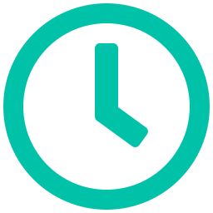

BONUS DEMO · IF WE HAVE TIME
From zero to a Discord bot in 3 nodes
Built live on stage — a schedule, a live API, and an auto-post to Discord. No OAuth, nothing to hang.
STEP 1
STEP 2
STEP 3
Schedule
HTTP GET
HTTP POST
Every 30 seconds
Pull a live API
Auto-post to Discord
↳ Open the linked screens in the speaker notes, in order, as you go.
Notes:
BONUS DEMO (run only if time allows) — BUILD A DISCORD AUTOMATION FROM SCRATCH (n8n) A 3-node workflow: every 30s, pull a live API, post to Discord. No OAuth — demo-proof. BEFORE STAGE — create the Discord webhook (once): - Discord channel (#n8n-demo) → gear (Edit Channel) → Integrations → Webhooks → New Webhook → name it → Copy Webhook URL → Save Changes. - PASTE YOUR WEBHOOK URL HERE: ______________________________ (Treat it like a password — anyone with it can post to your channel.) BUILD LIVE (n8n → https://obrienretailservices.app.n8n.cloud/home/workflows): Node 1 — Schedule Trigger: interval = Seconds → every 30. Node 2 — HTTP Request (GET): URL https://icanhazdadjoke.com/ , Header Accept: application/json. Execute step → a joke appears ('the data just showed up'). Node 3 — HTTP Request (POST): URL = your webhook. Send Body ON → JSON: { "content": "Auto-posted by n8n: {{ $json.joke }}" } Execute step → the message lands in Discord. If $json.joke is empty, use {{ $('HTTP Request').item.json.joke }} (that node's exact name). PAYOFF: flip the workflow to Active, step back — 'I'm not touching anything.' A new joke posts every 30s, hands-free. MIC-DROP (optional): drop an Edit Fields (Set) or AI Agent node between Node 2 and Node 3 to reformat the message, re-run — shows how easily it extends. API SWAP-INS: Vegas weather → https://wttr.in/Las%20Vegas?format=3 ({{ $json.data }}) ; Hacker News top stories. CHECKLIST: webhook ready; run end-to-end twice on venue wifi; Discord open on a 2nd screen; pin one success as a fallback; set the 30s interval ONLY right before the talk.

Slide 17
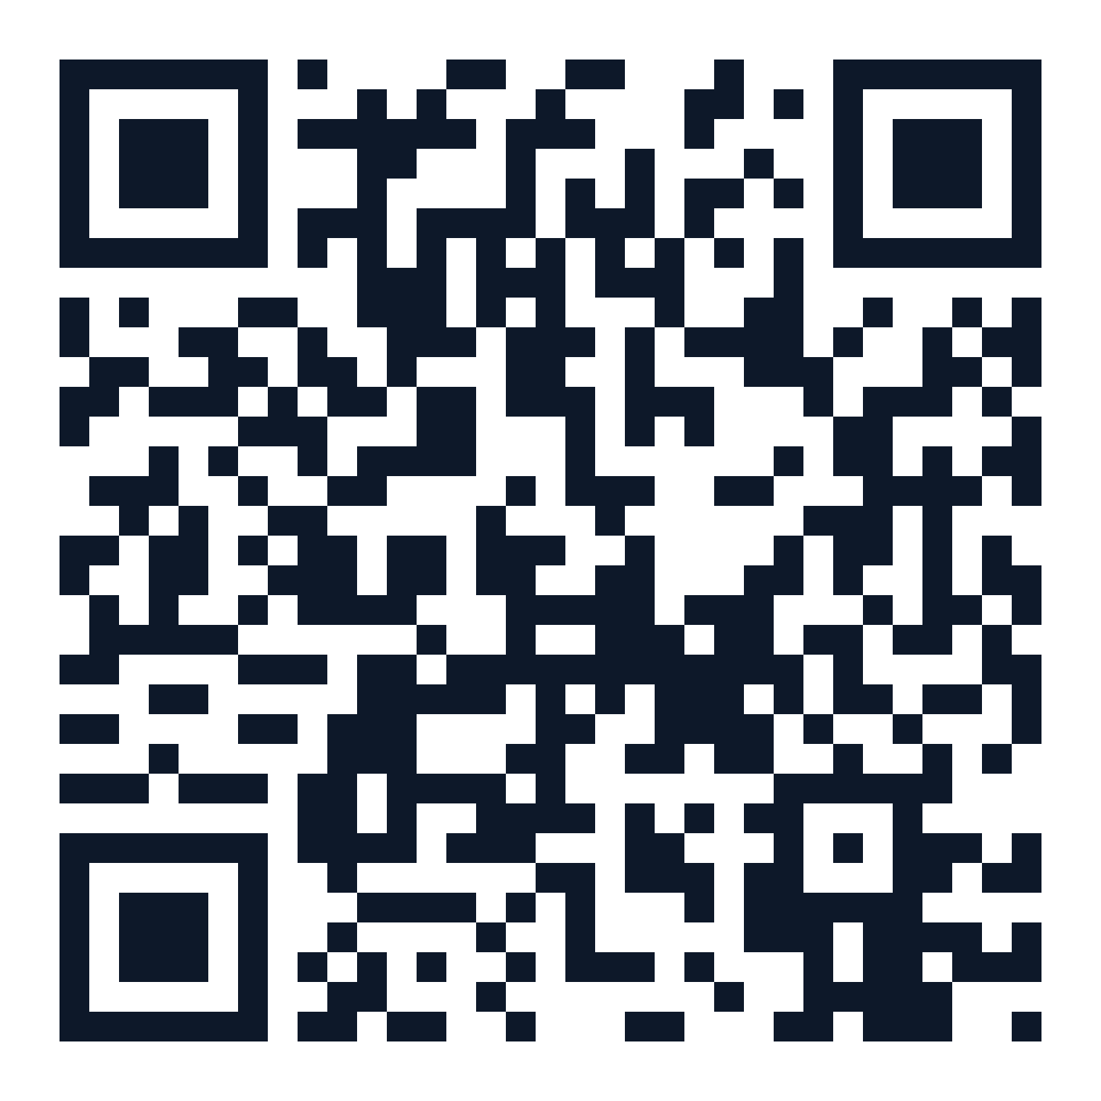
GET THE KIT
Take the whole system home
Scan for the Notion template, the n8n workflows,
the step-by-step setup guide, and the prompt library.
joshobrien77.github.io/AutomationKIT
SCAN ME
Points to the live landing page
Josh O'Brien · Startup Vegas 2026
Notes:
Closing slide — leave up during Q&A so people can scan. The QR points to the live landing page, which is Demo 1's lead form.

